Slide 1
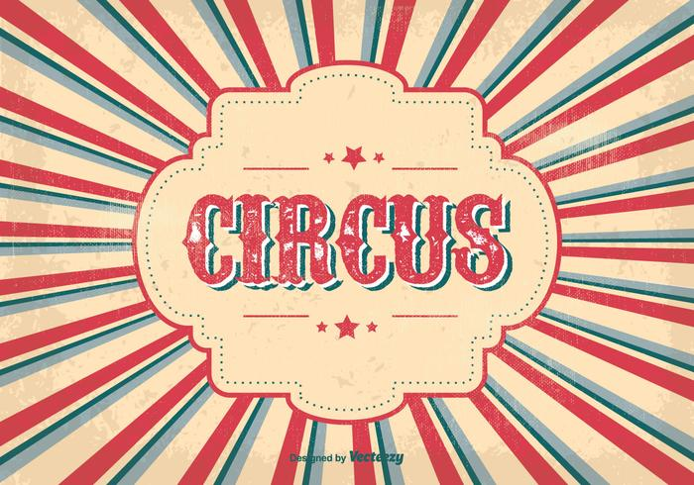
It’s a Three Ring Circus!

Slide 2

What is it?
-”A circus with simultaneous performances…..”-
Or
-”Something wild, confusing, engaging, or entertaining”-
Just like an Agriculture Education Program!

Slide 3

That is what an Ag Program is……
Classroom
SAE
FFA
Agriculture Educator- Leading the future of tomorrow!
Notes:
Split the class into 3 even groups after discussing the 3 Circle Model.

Slide 4

In your groups….
Fill Out Your Activity Sheet
Activity Sheet information:
  Group mascot
  Define your “ring”
  List your favorite activities/things about your “ring”
  How would you teach an Ag Science I class about your “ring”?
Notes:
Hand out Activity Sheet after describing the 3 Circle Agriculture Education Model (keep with the 3 ring circus theme). Have the mascot relate to the circus theme.

Slide 5
Combine the Rings!
Choose a Ringmaster and two assistants from your group
Making a circle intertwine the three rings
Present the following information:
  Ring definition
  Favorite activities
  How would your group teach your ring info to a class
Notes:
While students are presenting have them step into the middle of the 3 rings.

Slide 6
End of the Show
Although it may seem chaotic it is not
  The 3 rings represent:
    The core of what we do
    Important to building a strong Agriculture Program
    A basis for educators to influence the future leaders of tomorrow

Slide 7

Questions?

